Slide 1

Module code: T125B107
Module title: Introduction to Control Technologies
Arduino Robot Project
Student: Farhana Khanom Fariha
Assoc. Prof. Gintaras Dervinis

Slide 2
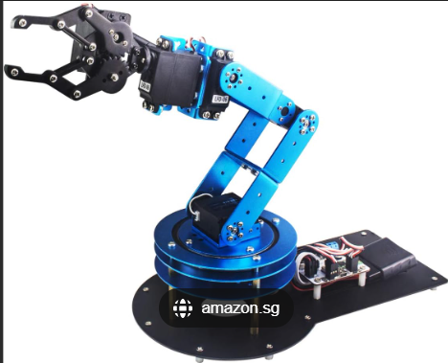
Introduction
Robots are used for automation in many industries
Robotic arms help in picking and placing objects
My goal was to build a simple robotic arm prototype
It can move and grip small items

Slide 3
My Robotic Arm Project
A robotic arm controlled using Arduino
Arm, forearm and gripper can move
It can pick and place small objects
Designed as a simple learning prototype

Slide 4
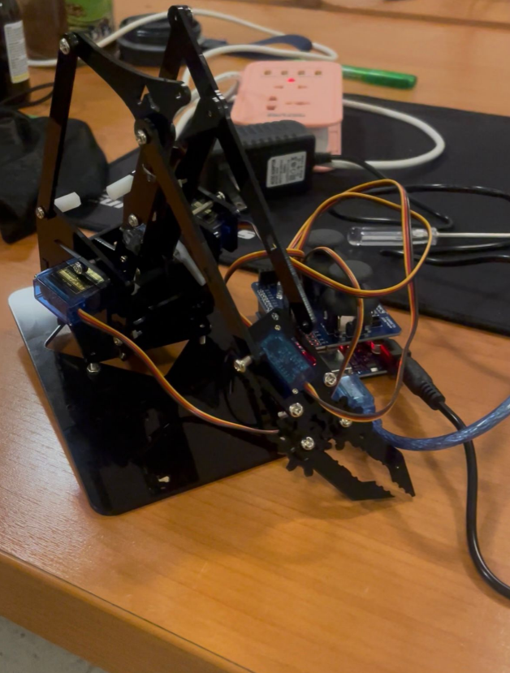
Prototype Assembly
Complete robotic arm model assembled on acrylic base
Arduino board connected to servo motors
Basic movements tested
Capable of gripping small objects
My Robotic Arm Prototype

Slide 5
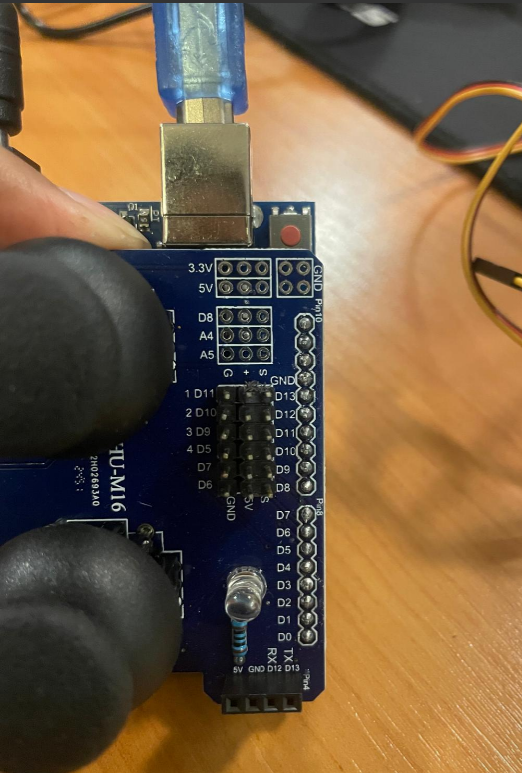
Hardware Components
Arduino Uno – main controller for the robot
Servo Motors (4x) – rotate joints and gripper
Robotic Arm– provides structure and movement range
Power Supply – stable energy for motors
Connecting Wires – signal and power connections

Slide 6
System Design
Arduino sends control signals to servo motors
Servo motors rotate the robotic arm joints
Gripper controlled for pick-and-place tasks
Power supply provides stable voltage to motors

Slide 7
User Input/Code
Arduino Uno
Servo Controller
Servo Motors
Robotic Arm Motion

Slide 8
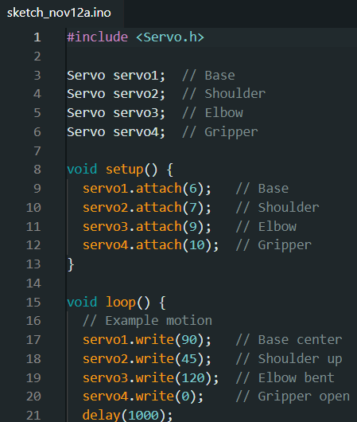
Programming & Control
Programmed using Arduino IDE
Servo motors control arm and gripper movements
Gripper opens and closes by servo rotation

Slide 9
Testing & Results:
Gripper opens and closes successfully
Forearm and arm can move properly
Able to hold light objects
Project goals for basic movement achieved

Slide 10
Challenges Faced
Limited lifting strength of the servo motors
Difficulties in stabilizing the arm movement
Wiring and connections needed corrections
Some joints not fully working yet

Slide 11
Advantages & Learning Outcomes
Learned how to assemble a robotic arm structure
Improved understanding of servo motor movement
Gained basic Arduino programming skills
Robot can grip and move light objects
Project is safe, simple and low-cost

Slide 12
Conclusion
Robotic arm prototype successfully built
Main movements and gripper are working
Project achieved its basic goals
Future upgrades can improve performance

